Slide 1
Student Interests System
Implementation in HTML CSS Ajax Python
Flask and MySQL Database

Slide 2
Introduction:
The Student Interests System is not just a database; it is a comprehensive solution designed to address the unique needs of managing student information and interests within our university.
The primary purpose of this system is to provide a centralized platform for administrators to efficiently handle student data, with a specific focus on their interests and activities within the academic environment.

Slide 3
Objectives:
Create a system to manage student data, focusing on interests.
Implement CRUD operations for student entities.
Develop a user management system with roles and permissions.
Generate informative dashboards to visualize key statistics.

Slide 4
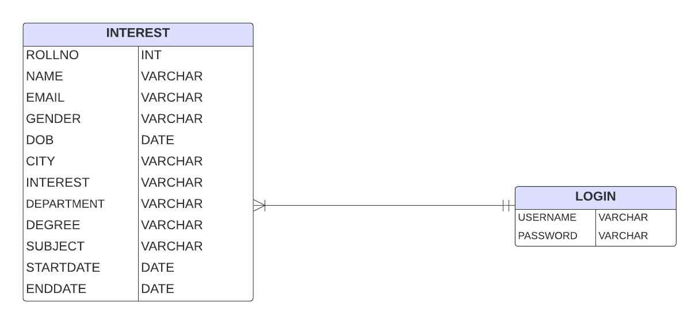
Entity Relationship Diagram

Slide 5
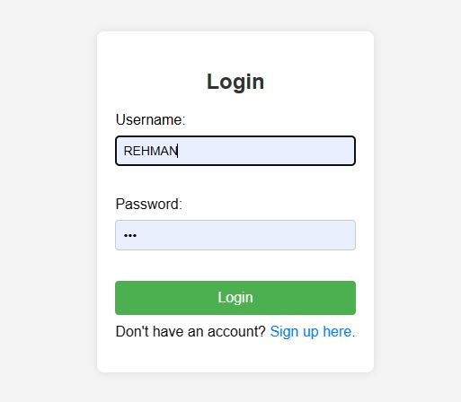
Flow of Program
Login Page:
At start of program user will see a login page and also a link to go to sign up page

Slide 6
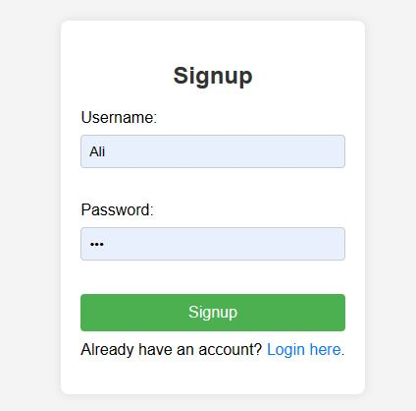
Flow of Program
Sign Up Page:
If user Click on “sign up Here” The user will see a sign up page that is below

Slide 7
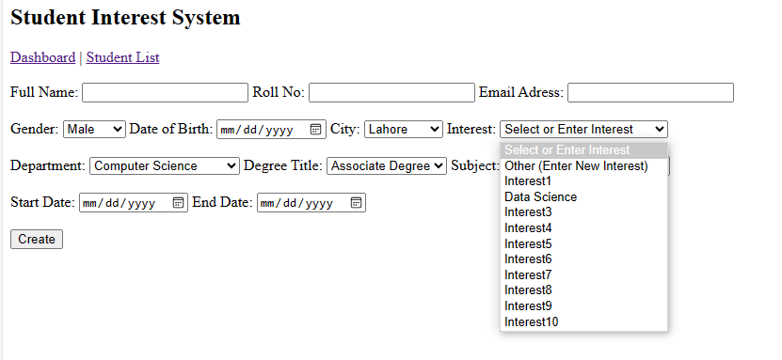
Flow of Program
Add Student Page:
When user successfully login, then he will be render to Add Student page that takes Student data. Also it fetch interest that is already in the database, when user click on create after giving data it add student data in database. It has also a hyperlink to go to “Dashboard” and one for See “Student List”

Slide 8
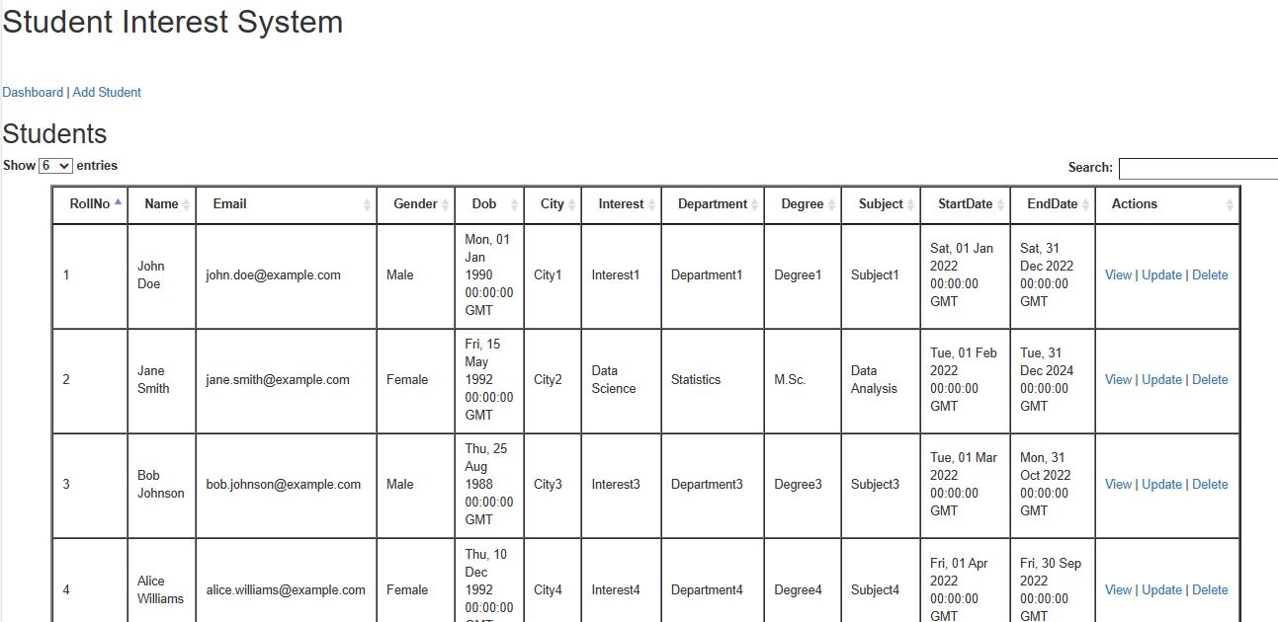
Flow of Program
Student List Page:
When user click on “Student List” hyperlink in add student page it will show all students data through Ajax. It has also hyper link to view update and delete for each student. It has also an option to change page size and also option for search on base of each attribute. It has also hyper link to Dashboard and Add Student.
When I click on delete hyperlink it delete that record from database and show remaining records.

Slide 9
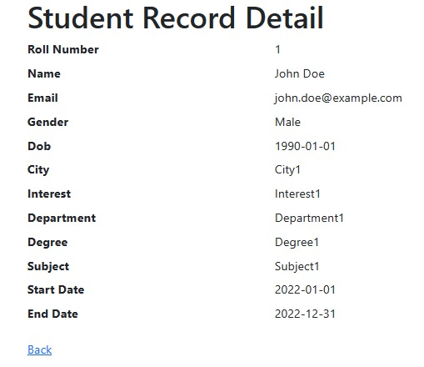
Flow of Program
View Page:
If user Click on “View” in Student List page, the user will see the record of that student on which user click. This page has also a back hyperlink that render to Student List page.

Slide 10
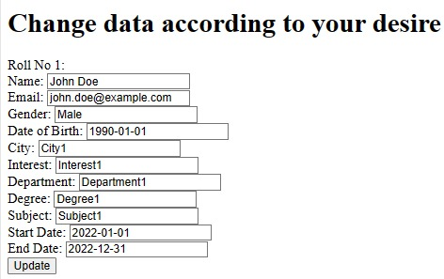
Flow of Program
Update Page:
If user Click on “Update” in Student List page, the user will see the fields that is already filled by data of that student on which user click. The user can change the field as his need and update it.

Slide 11
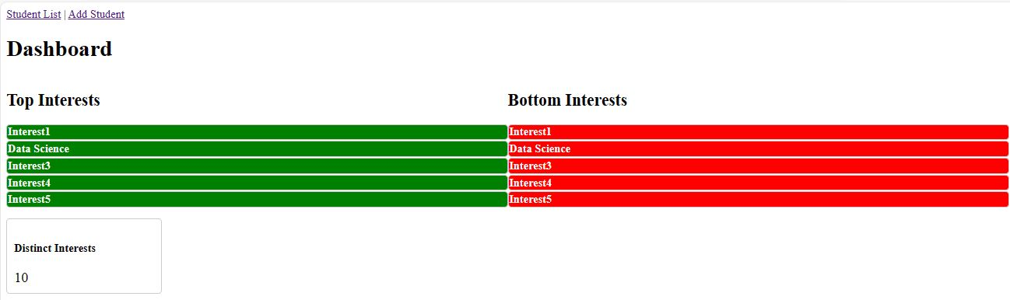
Flow of Program
Dashboard Page:
The dashboard page has a view of statically of Student Interest System.
Like below is top five and bottom five interests and also count of distinct interests.

Slide 12
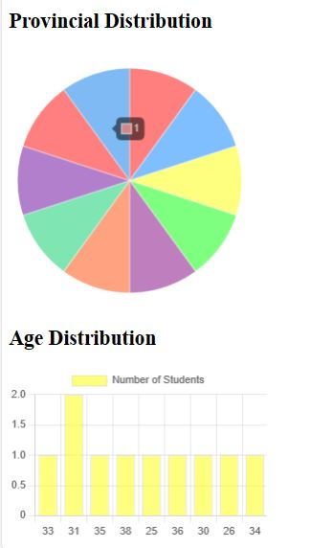
Flow of Program
Dashboard Page:
The dashboard page has a view of statically of Student Interest System.
Like below is Provincial distribution pie chart and Age Distribution bar chart.

Slide 13
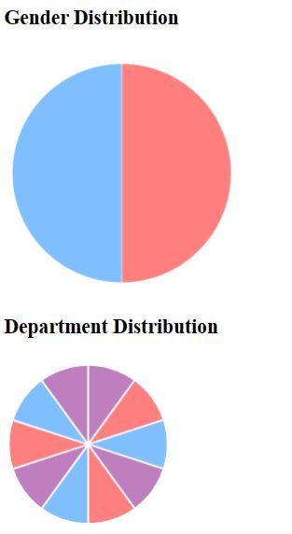
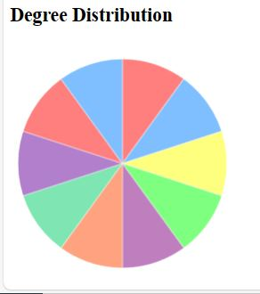
Flow of Program
Dashboard Page:
The dashboard page has a view of statically of Student Interest System.
Like below is Gender distribution and Department Distribution pie chart.
It has also Degree Distribution pie chart

Slide 14
Reasons for Technology Choices
Frontend: HTML, CSS, AJAX with jQuery
User-Friendly Web Pages:
I’m using HTML and CSS for building web pages that are easy to understand and navigate and also less time taken to learn.
Seamless Interactions:
AJAX with jQuery ensures smooth and quick interactions on the page without the need for refreshing.

Slide 15
Reasons for Technology Choices
Backend: Python Flask
Quick Development:
Flask, our backend technology, keeps things simple, making it easy to develop and maintain. Just give a link to render where you want to go.
Flexibility:
Flask allows us to add new features or modify existing ones without a hassle.
Speedy Prototyping:
It lets us create and test ideas rapidly during the development process.

Slide 16
Reasons for Technology Choices
Database: MySQL
Reliable Data Storage:
MySQL is a solid choice for storing our data reliably.
Community Help:
With a big community, we can easily find support and answers to questions.
Handles Growth:
It can grow with our system, handling more data and users as our project expands.
Works Well with Python:
Being compatible with Python makes communication between our backend and database seamless.

Slide 17

T

